Slide 1
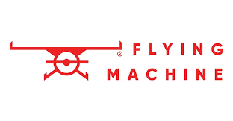
Comprehensive Digital Marketing Project Work
Brand :Flying Machine

Slide 2
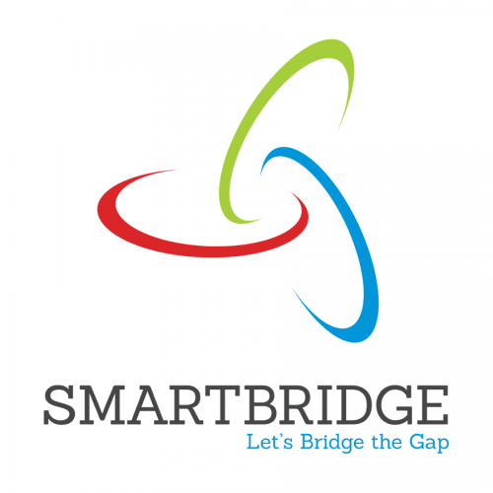
Project given by :

Slide 3
ACKNOWLEDGEMENT
The opportunity to participate in these internships has been an invaluable experience for my personal and professional development. I am extremely grateful to Dr. P L Madhava Rao sir for facilitating my placement with SMARTINTERZ and to Dr. P L Madhava Rao sir for providing me with guidance and mentorship throughout my time at Flying Machine Company.
My digital marketing internship at Flying Machine Company was an eye-opening experience that exposed me to the intricacies of marketing in the real world. Working closely with the team, I was able to contribute to various campaigns and initiatives, gaining hands-on experience in digital marketing strategies, analytics, and customer engagement.
I would also like to express my sincere appreciation to the college director, principal, and Head of the Department for providing me with the opportunity to undertake these internships as part of my academic curriculum. Your commitment to fostering practical learning experiences has greatly enriched my education.
I would also like to express my sincere appreciation to my team members for their unwavering support during my internship. Their encouragement, and willingness to share their expertise have been instrumental in my growth as a digital marketing professional.
Once again, thank you for the support and guidance that have made these internships a reality. I look forward to your feedback and am open to any further recommendations or suggestions for my future endeavors.

Slide 4
TEAM MEMBERS
Team lead : Podila Pravallika
Team member : Shaik Anwar basha
Team member : Shaik Muzavar Abdul Samad
Team member : Gopidesi Venkatesh
Team member : Naraboina Rajesh

Slide 5
Brand study, Competitor Analysis & Buyer’s/Audience’s Personal
Flying Machine is an Indian denim and casual wear brand owned by Arvind Limited. It was launched in 1980 and has since become a prominent name in the Indian fashion industry. Here's a brief analysis of the Flying Machine clothes brand:
*Market Positioning:* Flying Machine is positioned as a youth-oriented brand that offers trendy and fashionable denim and casual wear. It's known for its edgy and contemporary designs, appealing to the younger demographic.

Slide 6
Analysis:
*Target Audience:* The brand primarily targets the urban youth and young adults who are fashion-conscious and value style and individuality. Its designs cater to those who want to make a statement with their clothing choices.
Product Range:* Flying Machine offers a wide range of products including jeans, shirts, t-shirts, jackets, and accessories. Its focus on denim products has helped it carve a niche in the Indian fashion market.

Slide 7

Collaborations:
Flying Machine has collaborated with various celebrities and influencers to enhance its brand image and appeal to its target audience.

Slide 8
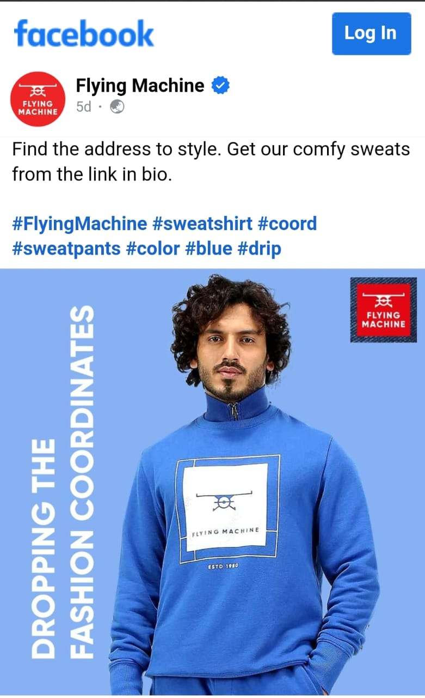
*Social Media:*
The brand is active on social media platforms, connecting with its target audience through engaging content and influencer partnerships.

Slide 9
History of Flying Machine:
Flying Machine is one of the indigenously grown brands started by garment division of Arvind mills. The brand was incepted in 80’s; Flying Machine is among few early brands which started the denim category in India though consumption was pretty low. The brand had the positioning of ‘guaranteed brand’ due to its unique pricing and product innovation. However, with the growing penetration of online retail and multiple retail channels, the brand started experiencing operational huddle in managing inventory as it goes on multiple channels.

Slide 10
Progress:
Since integrating with the Rubicon platform, Flying Machine has increased its online visibility, strengthened its marketplace business and grown its sales quite significantly. Moreover, the platform allowed Flying Machine to showcase all their categories and reach out to newer marketplaces and significantly increase their sell-throughs.
Following are the few impacts that Rubicon enabled for Flying Machine from Q1 17-18 to Q4 17-18.
23 times rise in GMV
22 times rise in orders across marketplaces
Fulfilment rate increased to 98.99%
Sell through increased by 25%

Slide 11
Flying Machine India Company Profile
Company Full Name: Arvind Limited
Type: Private
Industry: Fashion wear
Founded Year: 1980
Founder: NA
Headquarters: Naroda, Ahmedabad, Gujarat, India
Key People: Mr. Sanjay Lalbha (CEO & MD)
Parent Company: Lalbhai Group
Subsidiaries: NA

Slide 12
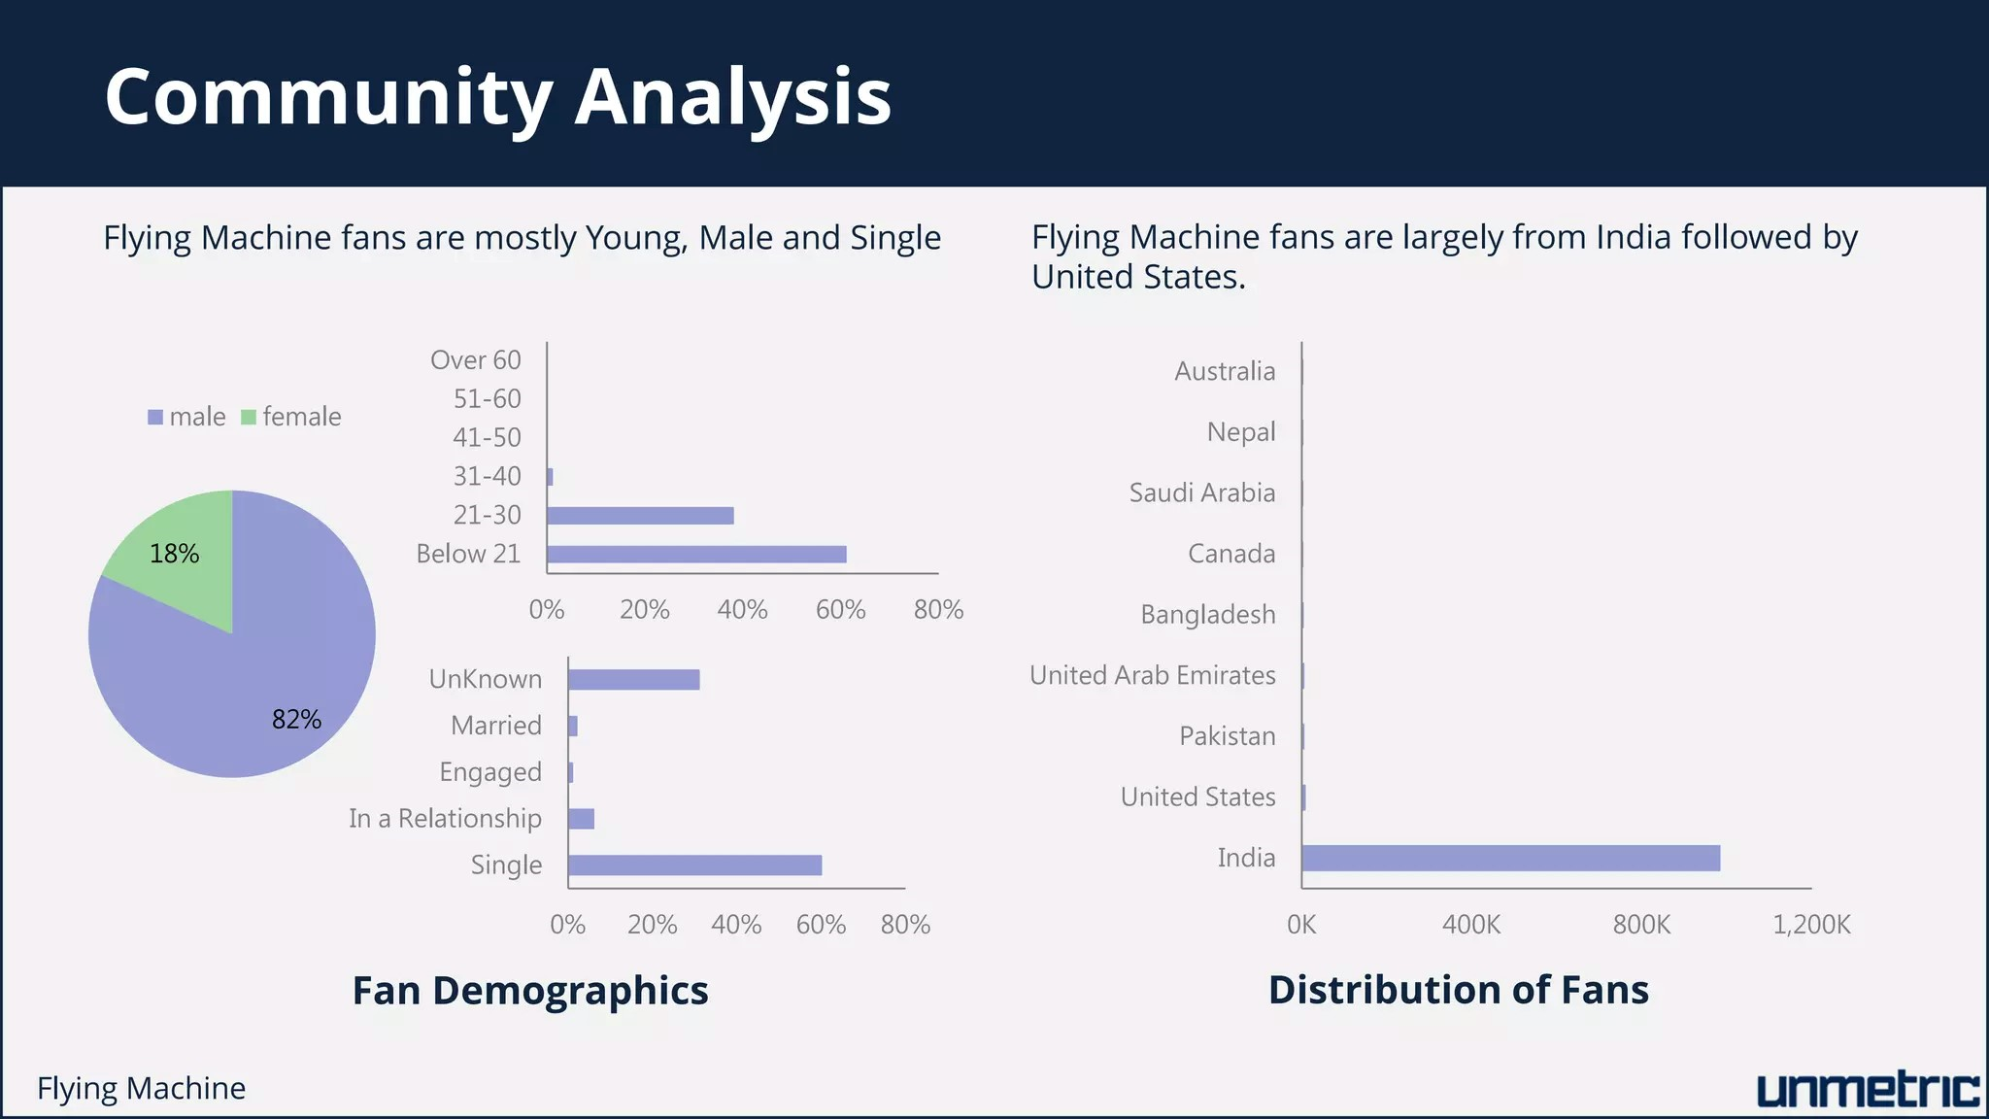
SEO & Keyword Research:
An SEO audit is a comprehensive evaluation of a website's search engine optimization (SEO) performance and overall health. The main purpose of an SEO audit is to identify areas of improvement and uncover issues that may be hindering the website's ability to rank well in search engine results. The SEO audit for lakme is as follows:

Slide 13
Rankings of keywords:
Keyword rankings refer to the positions that specific keywords or key phrases hold in the search engine results pages (serps) when users search for those terms.
#3 Denim Brand in the country.
• India's first homegrown denim brand and one of the coolest youth apparel brands in the country with a play in denims, tees and casual shirts
• Well defined categories with Innovative jeans wear in FM, Entry price point heavy in FMX range & Urban play for digital natives in FM2001
• FMX Model stores for small tier towns of India, and strategic partnership with Flipkart group to strengthen its innovative, online first mindset
• Size : ~400+ Cr NSV turnover
• Revenue CAGR# : 18%
• Store Count : 250+

Slide 14
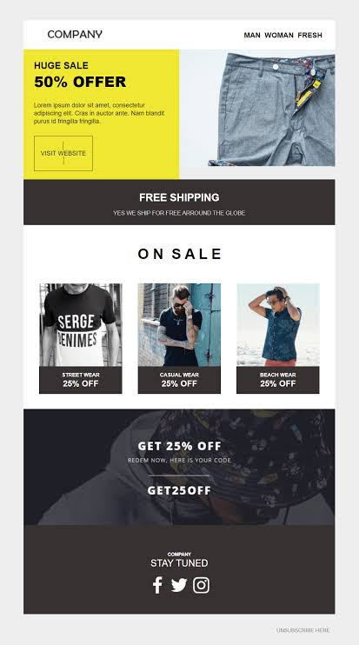
Email Marketing:
Flying Machine Head Office Email ID: care@nnnow.com
Retail brands like fashion stores have an industry average open rate of 18.39% and an average click rate of 2.25% for their marketing emails, according to Mailchimp.
There’s a reason the average return on investment for email marketing is still $42 for every dollar. It’s simple yet so effective. In total, email marketing is responsible for 81% of customer acquisition and 80% of customer retention.

Slide 15
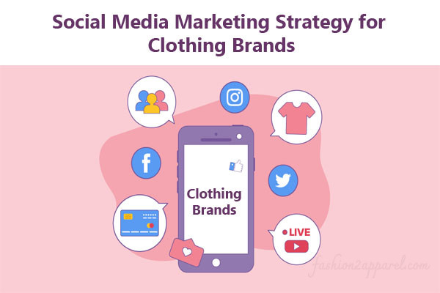
Social Media Marketing:
In addition to managing your social media accounts, influencer marketing should be an essential part of your overall strategy. Influencer marketing budgets are increasing year-over-year, with 17 percent of companies planning to spend more than half of their budget on this marketing method. There are several ways you can work with influencers to increase sales and spread brand awareness.

Slide 16
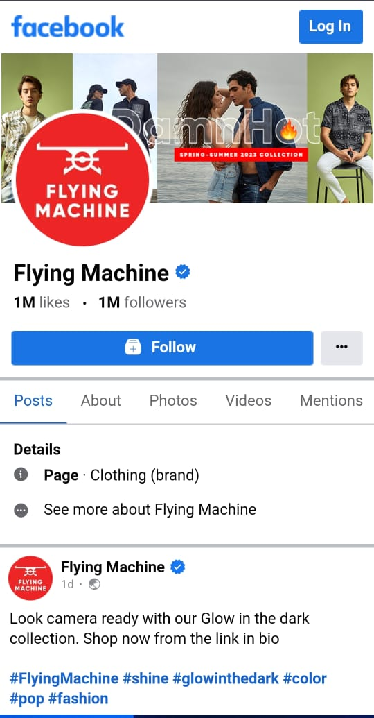
Facebook
Facebook is the most used social media platform in the world with 2.45 billion monthly active users. In addition to regular Facebook posts, fashion app marketers can use the platform for live broadcasts. For example, ASOS went live with ‘100 layers of ASOS,’ a short contest between ASOS staff members where they had 30 minutes to create a look for their models – using 100 layers for ASOS clothing dramatic effect.

Slide 17
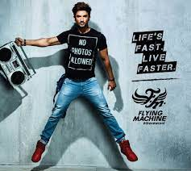
Instagram:
Instagram has an active global audience of 500 million daily active users, collectively tapping the platform’s “Like” button 4.2 billion times every day. Ecommerce merchants can also use Instagram’s shopping feature, allowing users to purchase items without leaving the app. Instagram offers several ways to connect with your audience, including Posts, Reels, Stories, Highlights and IGTV. Instagram is synonymous with social media fashion influencers and 69 percent of marketers plan to spend more money on Instagram influencers than any other market this year.
Link :
https://instagram.com/flyingmachine80?igshid=MmU2YjMzNjRlOQ==

Slide 18
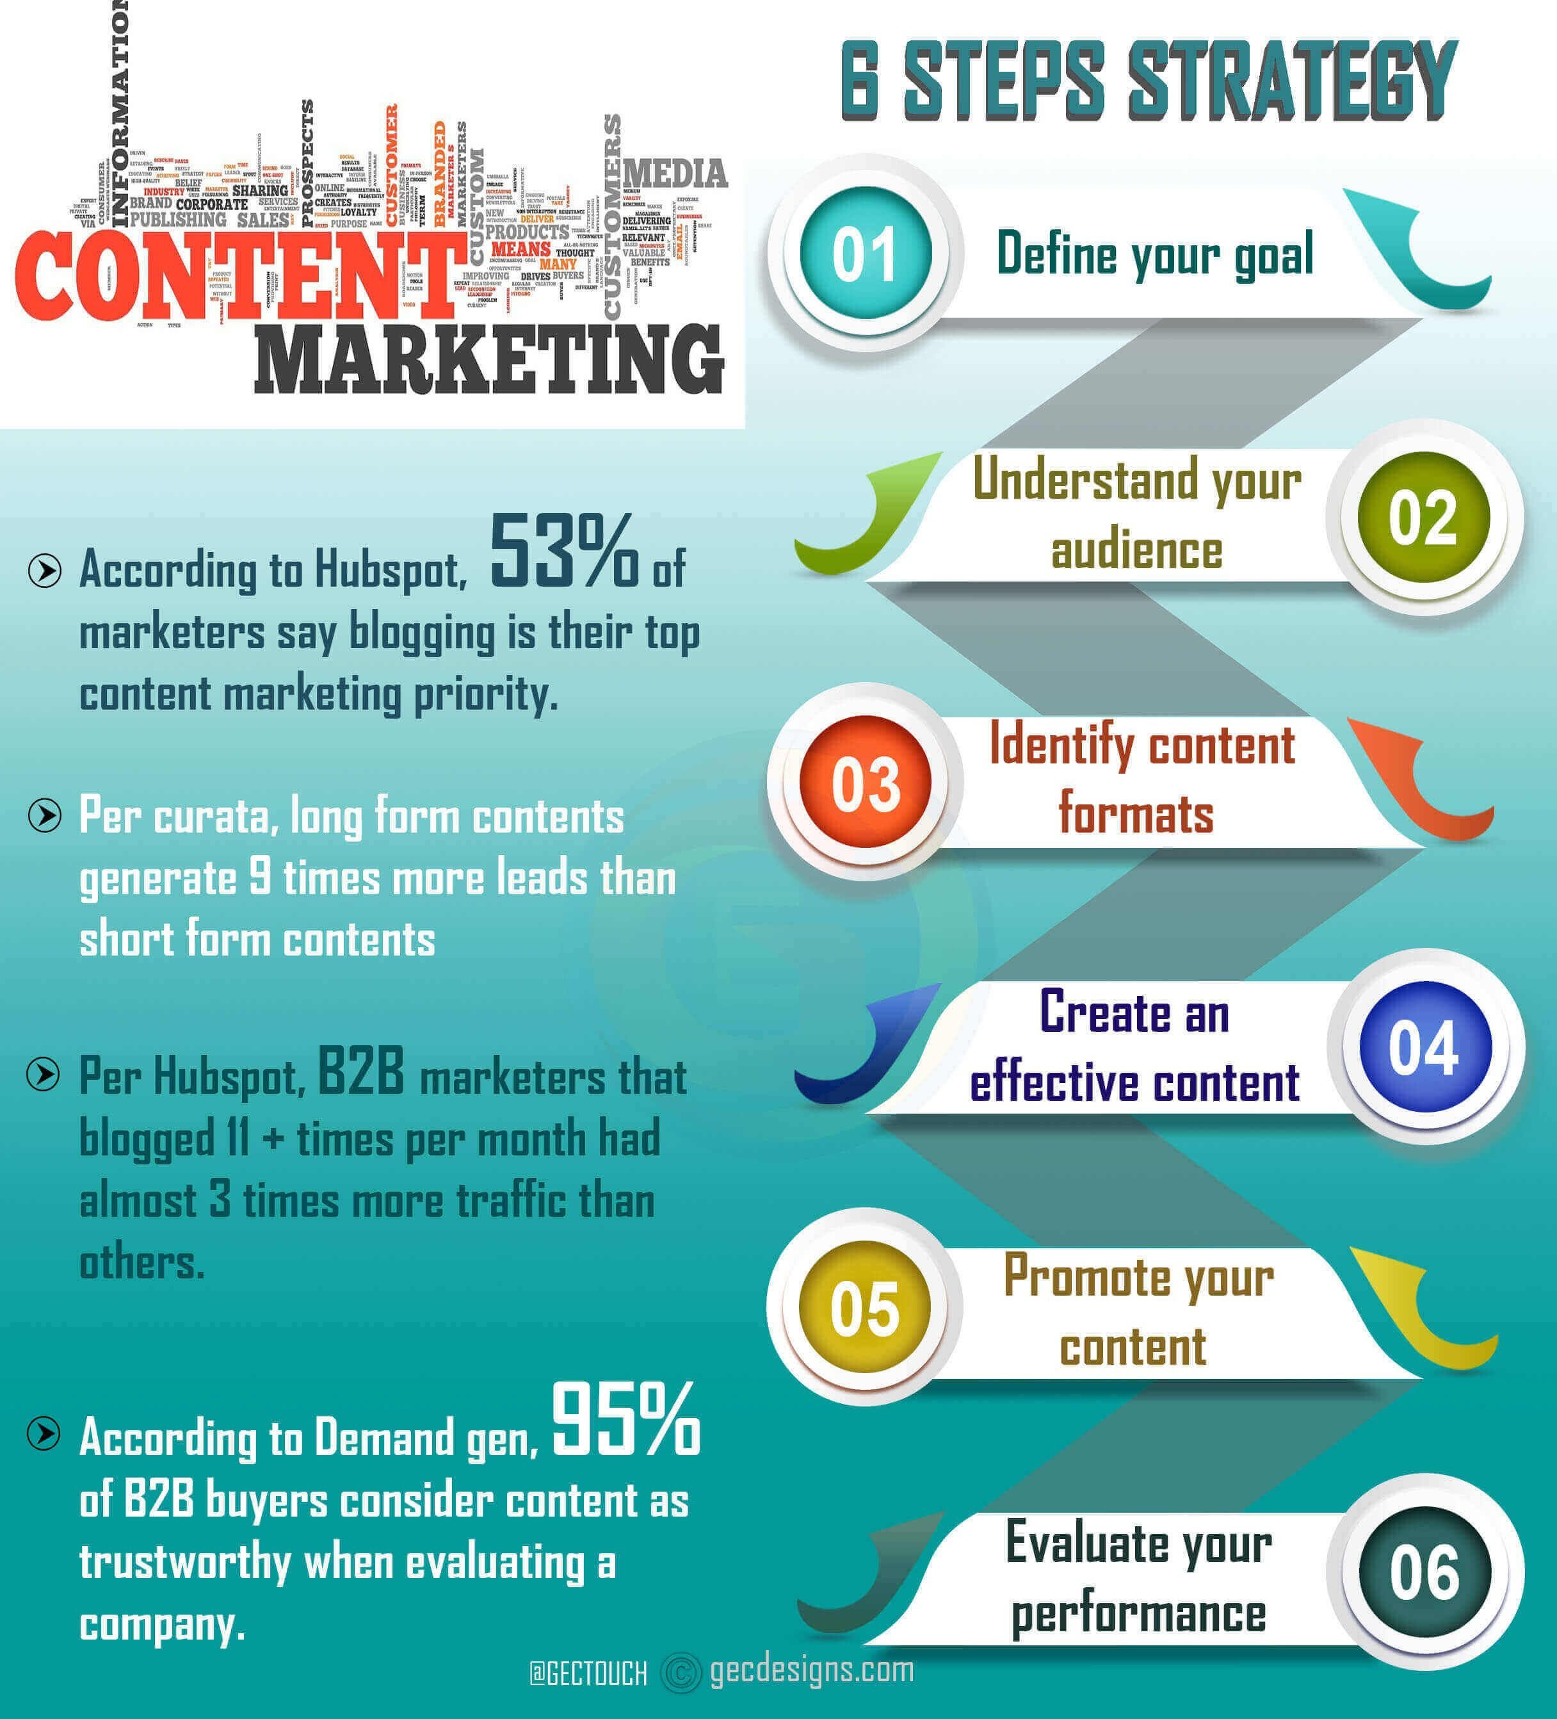
Content Marketing:
Content marketing is an essential strategy that allows businesses to reach, engage and connect with clients through unique content.
This generally involves creating exciting and unique content in the form of blog posts, videos and infographics. The goal is to use keywords that appeal to or stick to the client’s memory, thus motivating them to consider your product or service.

Slide 19
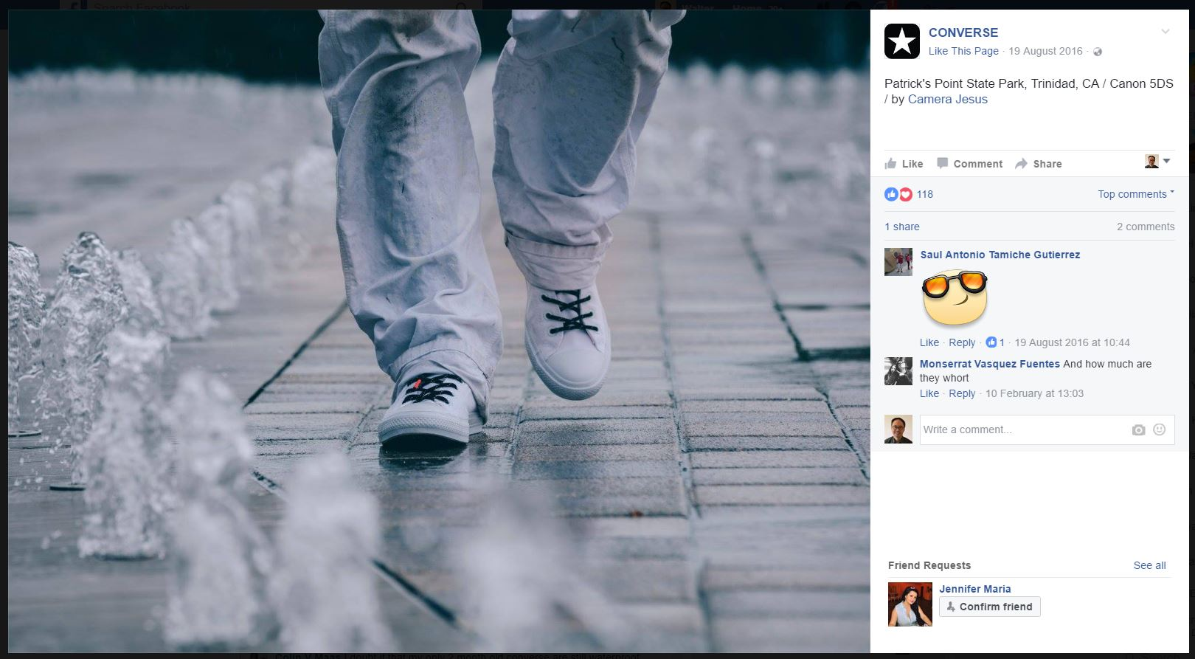
Content Marketing stratagies
By making vlogs, videos, adds,photography and so on we can make content marketing stratagies

Slide 20
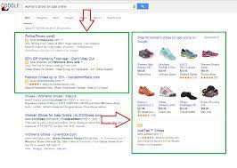
Pay per click advertising:
Pay per click advertising is a very effective digital marketing strategy. It involves paid advertisement wherein the business pays for specific keywords such that when a person searches using those keywords, the particular business site appears.

Slide 21
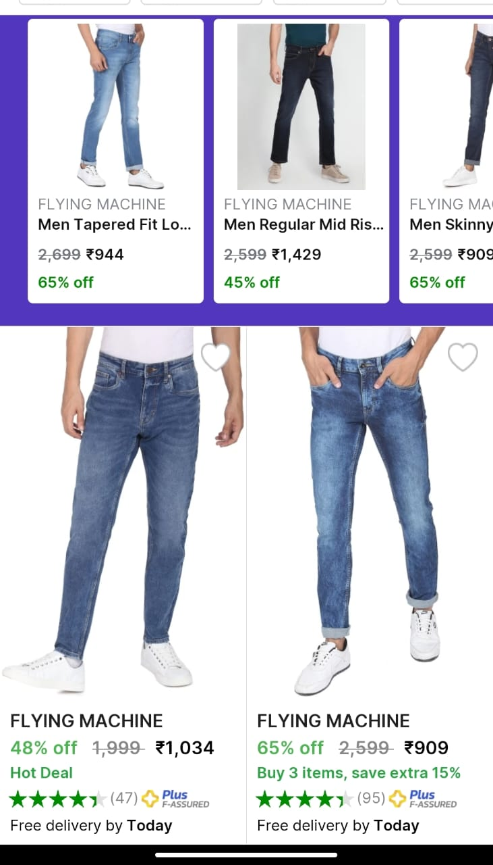
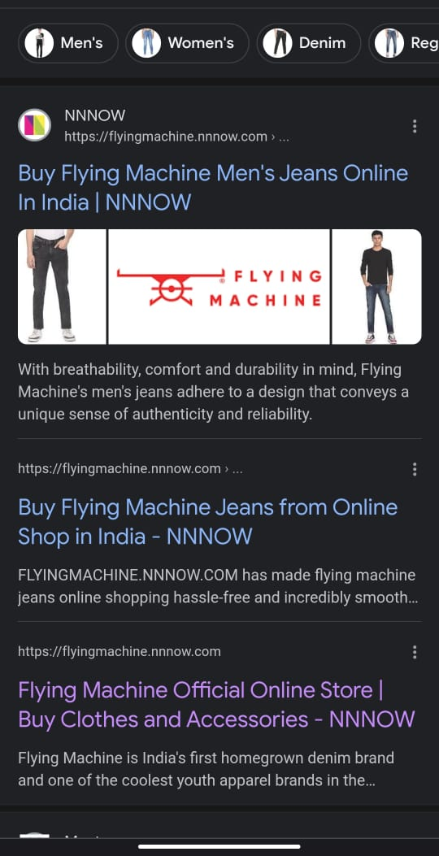
Pay per click:
It involves paid advertisement where in the business pays for specific keywords such that when a person searches using those keywords, the particular business site appears.

Slide 22
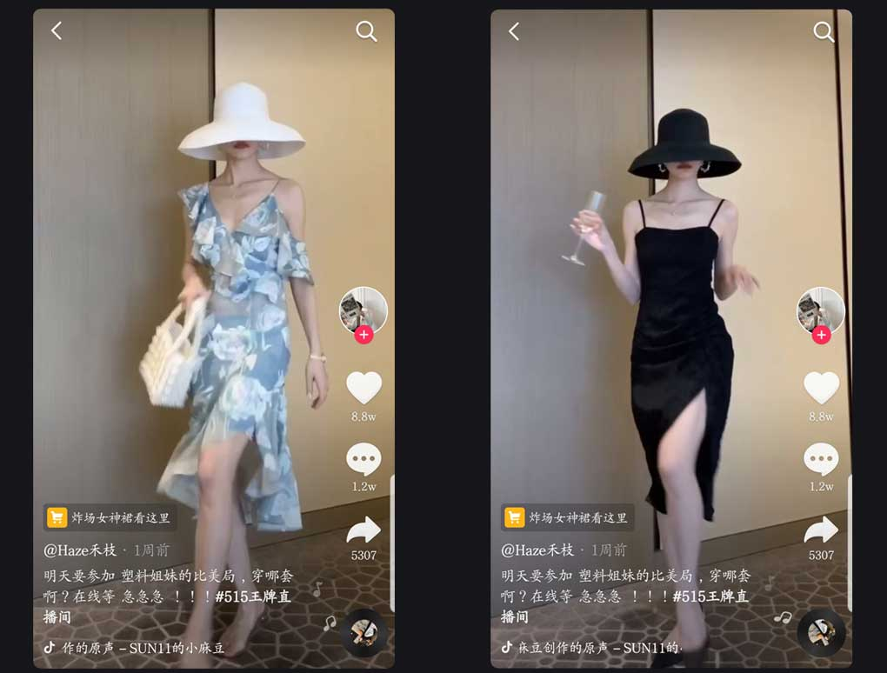
Video marketing:
Video marketing refers to the strategic usage of digital marketing videos to increase brand awareness, conversion rates and company revenues. It does so by creating unique video content that may be a form of announcement, behind the scenes video, event-based video or even a quirky new advertisement.
Before you dive into digital marketing activities, do a considerable bit of research. Find out what platforms and channels suit you best. There are too many variables to discuss at length here. It is always better to go deep in one or two channels than too thinly spreading across many channels and losing focus.

Slide 23
THANK YOU

